Slide 1
Segmentation, Targeting & Positioning
Lecture 4

Slide 2
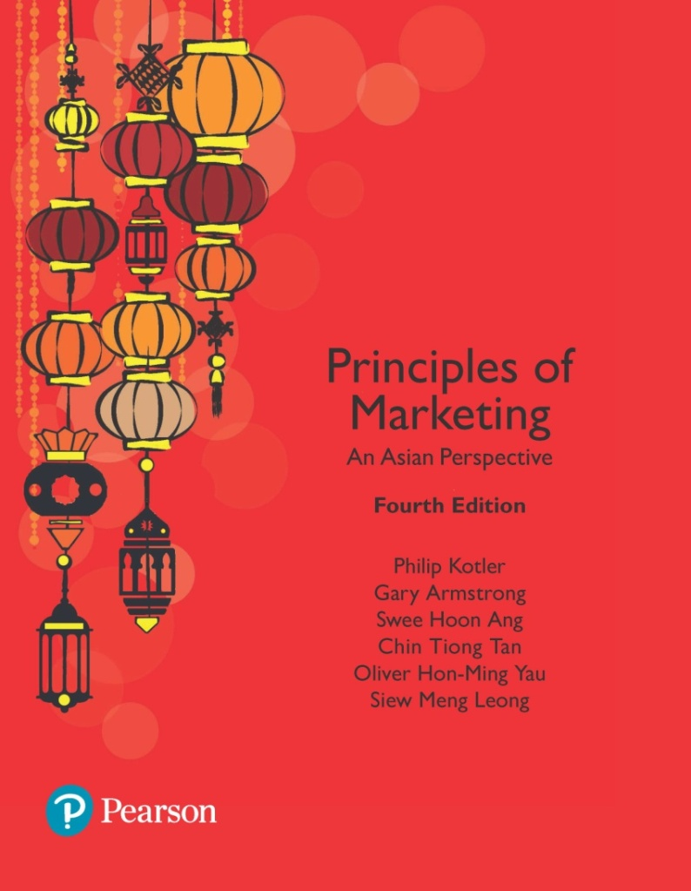
Customer-Driven Marketing Strategy: Creating Value for Target Customers
Chapter 7

Slide 3
Learning Objectives
7.1 Define the major steps in designing a customer-driven marketing strategy: market segmentation, targeting, differentiation, and positioning.
7.2 List and discuss the major bases for segmenting consumer and business markets.
7.3 Explain how companies identify attractive market segments and choose a market-targeting strategy.
7.4 Discuss how companies differentiate and position their products for maximum competitive advantage.
Notes:
Objective 1 Define the major steps in designing a customer-driven marketing strategy: market segmentation, targeting, differentiation, and positioning.
Objective 2 List and discuss the major bases for segmenting consumer and business markets.

Slide 4
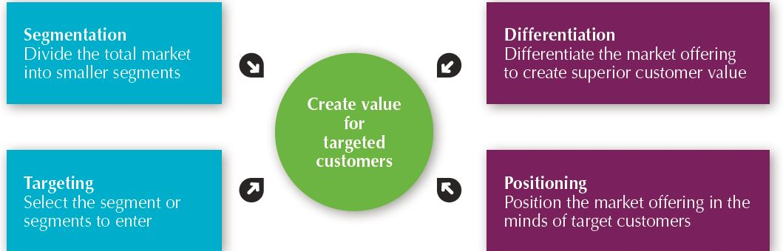
Customer-Driven Marketing Strategy
Figure 7.1 Steps in Market Segmentation, Targeting, and Positioning

Slide 5
Market Segmentation
Market segmentation requires dividing a market into smaller segments with distinct needs, characteristics, or behaviors that might require separate marketing strategies or mixes.
Notes:
Buyers in any market differ in their wants, resources, locations, buying attitudes, and buying practices. Through market segmentation, companies divide large, heterogeneous markets into smaller segments that can be reached more efficiently and effectively with products and services that match their unique needs.

Slide 6
Major Segmentation Variables for Consumer Markets
Segmentation Variable | Examples
Geographic | Nations, regions, states, counties, cities, neighborhoods, population density (urban, suburban, rural), climate
Demographic | Age, life-cycle stage, gender, income, occupation, education, religion, ethnicity, generation
Psychographic | Social class, lifestyle, personality
Behavioral | Occasions, benefits, user status, usage rate, loyalty status

Slide 7
Market Segmentation
Segmenting Consumer Markets
Geographic segmentation divides the market into different geographical units such as nations, regions, states, counties, cities, or even neighborhoods.

Slide 8
Market Segmentation
Segmenting Consumer Markets
Demographic segmentation divides the market into segments based on variables such as age, life-cycle stage, gender, income, occupation, education, religion, ethnicity, and generation.
Age and life-cycle stage segmentation divides a market into different age and life-cycle groups.
Gender segmentation divides a market into different segments based on gender.
Income segmentation divides a market into different income segments.

Slide 9
Market Segmentation
Segmenting Consumer Markets
Psychographic segmentation divides a market into different segments based on social class, lifestyle, or personality characteristics.
Behavioral segmentation divides a market into segments based on consumer knowledge, attitudes, uses of a product, or responses to a product.

Slide 10
Market Segmentation
Segmenting Consumer Markets
Behavioral Segmentation
Occasions
Benefits sought
User status
Usage rate
Loyalty status
Notes:
Benefit segmentation: Schwinn makes bikes for every benefit segment.
Occasions refer to when consumers get the idea to buy, actually make their purchase, or use the purchased item. Occasion segmentation can help firms build up product usage.
Benefits sought refers to finding the major benefits people look for in a product class, the kinds of people who look for each benefit, and the major brands that deliver each benefit.
Markets can be segmented by user status: nonusers, ex-users, potential users, first-time users, and regular users of a product. Marketers want to reinforce and retain regular users, attract targeted nonusers, and reinvigorate relationships with ex-users.
Markets can also be segmented by usage rate: light, medium, and heavy product users. Heavy users are often a small percentage of the market but account for a high percentage of total consumption.
Consumers can be loyal to brands, and buyers can be divided into groups according to their degree of loyalty. Some consumers are completely loyal—they buy one brand all the time and can’t wait to tell others about it. Other consumers are somewhat loyal—they are loyal to two or three brands of a given product or favor one brand while sometimes buying others. Still other buyers show no loyalty to any brand—they either want something different each time they buy, or they buy whatever’s on sale. A company can learn a lot by analyzing loyalty patterns in its market, starting with its own loyal customers.

Slide 11
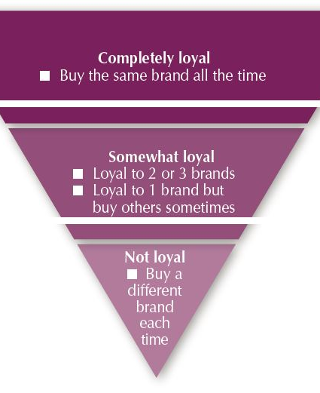
Market Segmentation
Segmenting Consumer Markets
Using Multiple Segmentation Bases
Multiple segmentation is used to identify smaller, better-defined target groups.
Loyalty Status
Undivided Loyalty
Divided/Split Loyalty
Spurious Loyalty (repeat purchaser due to situational constraints (such as vendor lock-in), a lack of viable alternatives, or out of convenience.)
Latent Loyalty (favourite attitude but low repeat purchaser)
No brand loyalty
Deal-Prone
Variety Seekers
Notes:
Marketers rarely limit their segmentation analysis to only one or a few variables. Rather, they often use multiple segmentation bases in an effort to identify smaller, better defined target groups. Several business information services like Experian provide multivariable segmentation systems that merge geographic, demographic, lifestyle, and behavioral data to help companies segment their markets down to zip codes, neighborhoods, and even households.

Slide 12
Which Segmentation Base to Use?
Qualifying
the dimensions that are relevant to including a customer type in a product-market.
Who are you targeting?
It is the attribute(s) that determine the segmentation. For example segmentation by demographics, psychographics, behavioural, geographic
Determinant
the dimensions that actually affect the customer's purchase of a specific product or brand in a product-market.
Why are you targeting them?
It is the attribute(s) that the consumer uses to ultimately distinguish one service offering from another. For example, it could be convenience, location, service, price
Notes:
Additional reading
https://hbr.org/1964/03/new-criteria-for-market-segmentation

Slide 13
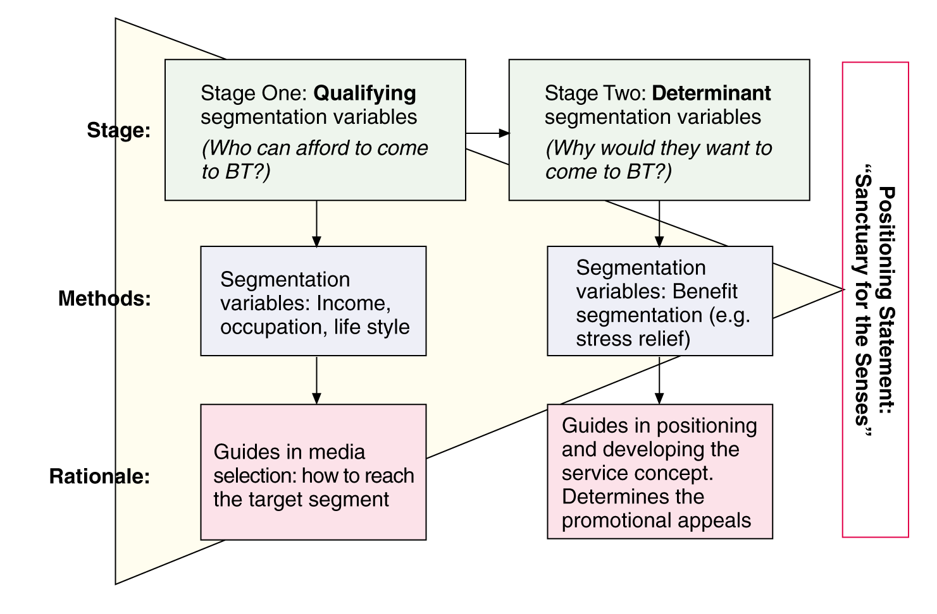
Application of Multi-Stage Segmentation Banyan Tree

Slide 14
Market Segmentation
Requirements for Effective Segmentation
Measurable - Size, purchasing power, and profiles of the segments can be measured
Accessible - Market segments can be effectively reached and served
Substantial - Market segments are large or profitable enough to serve
Differentiable - Segments are conceptually distinguishable and respond differently to different marketing mix elements and programs
Actionable - Effective programs can be designed for attracting and serving the segments

Slide 15
Market Targeting
Evaluating Market Segments
Segment size and growth
Segment structural attractiveness
Company objectives and resources

Slide 16
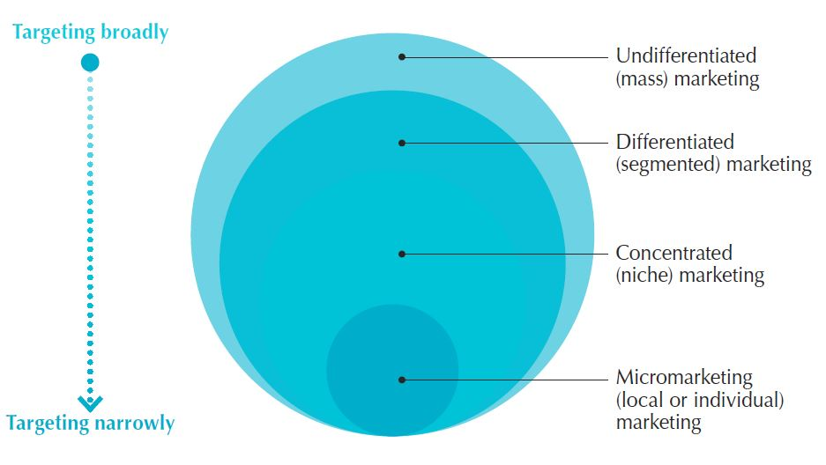
Market Targeting
Selecting Target Market Segments
A target market is a set of buyers who share common needs or characteristics that the company decides to serve.
Notes:
After evaluating different segments, the company must decide which and how many segments it will target. Market targeting can be carried out at several different levels as shown in the next slide.

Slide 17
Market Targeting
Selecting Target Market Segments
Undifferentiated marketing targets the whole market with one offer.
Mass marketing
Focuses on common needs rather than what’s different
Differentiated marketing targets several different market segments and designs separate offers for each.
Goal is to achieve higher sales and stronger position
More expensive than undifferentiated marketing
Notes:
With undifferentiated marketing (or mass marketing), the company designs a product and a marketing program that will appeal to the largest number of buyers.
As noted in the chapter, most modern marketers have strong doubts about this strategy. Difficulties arise in developing a product or brand that will satisfy all consumers. Moreover, mass marketers often have trouble competing with more-focused firms that do a better job of satisfying the needs of specific segments and niches.
P&G markets six different laundry detergent brands in the United States, which compete with each other on supermarket shelves. Then, P&G further segments each brand to serve even narrower niches.
Developing a stronger position within several segments creates more total sales than undifferentiated marketing across all segments.
Differentiated marketing increases the costs of doing business. The company must weigh increased sales against increased costs when deciding on a differentiated marketing strategy.

Slide 18
Market Targeting
Selecting Target Market Segments
Concentrated marketing targets a large of a smaller market.
Limited company resources
Knowledge of the market
More effective and efficient
Micromarketing is the practice of tailoring products and marketing programs to suit the tastes of specific individuals and locations.
Local marketing
Individual marketing
Notes:
Concentrated marketing: Using a concentrated marketing (or niche marketing) strategy, instead of going after a small share of a large market, the firm goes after a large share of one or a few smaller segments or niches.
Today, the low cost of setting up shop on the Internet makes it even more profitable to serve seemingly miniscule niches. Small businesses, in particular, are realizing riches from serving small niches on the Web.
Concentrated marketing can be highly profitable. At the same time, it involves higher-than-normal risks. Companies that rely on one or a few segments for all of their business will suffer greatly if the segment turns sour. Or larger competitors may decide to enter the same segment with greater resources. For these reasons, many companies prefer to diversify in several market segments. In fact, many large companies develop or acquire niche brands of their own.
Rather than seeing a customer in every individual, micromarketers see the individual in every customer. Micromarketing includes local marketing and individual marketing described on the next slides.

Slide 19
Market Targeting
Selecting Target Market Segments
Individual marketing involves tailoring products and marketing programs to the needs and preferences of individual customers.
Also known as:
One-to-one marketing
Mass customization
Notes:
Individual marketing: The PUMA Factory sneaker customization web site lets customers tailor their PUMA shoes to taste. “You know what works—what
styles, what textures, what colors. Customize your sneakers whatever way you want.”
In the extreme, micromarketing becomes individual marketing— one-to-one or markets-of-one marketing.
More detailed databases, robotic production and flexible manufacturing, and interactive media such as mobile phones and the Internet have combined to foster mass customization. Mass customization is the process by which firms interact one-to-one with masses of customers to design products and services tailor-made to individual needs. Individual marketing has made relationships with customers more important than ever.
The world appears to be coming full circle—from the good old days when customers were treated as individuals to mass marketing when nobody knew your name and then back again.

Slide 20
Market Targeting
Choosing a Target Strategy
Choosing a targeting strategy depends on
Company resources
Product variability
Product life-cycle stage
Market variability
Competitor’s marketing strategies

Slide 21
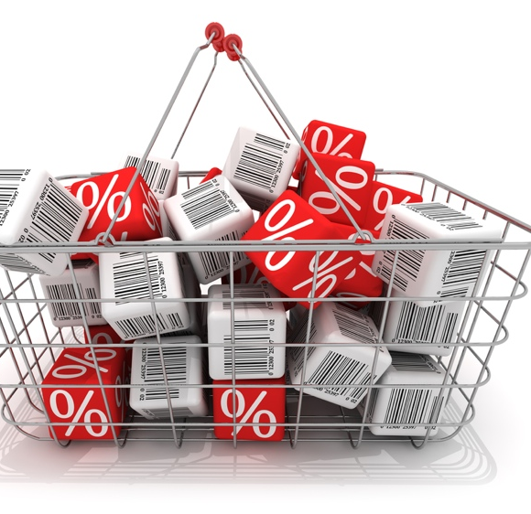
Market Targeting
Selecting Target Market Segments
Socially Responsible Target Marketing
Benefits customers with specific needs
Concern for vulnerable segments
Notes:
Socially responsible targeting: Target marketing sometimes generates controversy and concern. For example, fast-food chains have generated controversy over the years by their attempts to target inner-city minority consumers. They’ve been accused of pitching their high-fat, salt laden fare to low-income, urban residents who are much more likely than suburbanites to be heavy consumers. Similarly, big banks and mortgage lenders have been criticized for targeting consumers in poor urban areas with attractive adjustable-rate home mortgages that they can’t really afford.
Children are seen as an especially vulnerable audience. Marketers in a wide range of industries—from cereal, soft drinks, and fast food to toys and fashion—have been heavily criticized for their marketing efforts directed toward children.
In target marketing, the issue is not really who is targeted but rather how and for what. Controversies arise when marketers attempt to profit at the expense of targeted segments—when they unfairly target vulnerable segments or target them with questionable products or tactics.
Socially responsible marketing calls for segmentation and targeting that serve not just the interests of the company but also the interests of those targeted.

Slide 22
Differentiation and Positioning
Product position is the way the product is defined by consumers on important attributes.
Choosing a Differentiation and Positioning Strategy
Identifying a set of possible competitive advantages to build a position
Choosing the right competitive advantages
Selecting an overall positioning strategy
Communicating and delivering the chosen position to the market
Notes:
Positioning: For example, in the automobile market, the Honda Fit is positioned on economy, Mercedes on luxury, and BMW on performance. Volvo positions powerfully on safety. And Toyota positions its fuel-efficient, hybrid Prius as a high-tech solution to the energy shortage.
The company must decide on a value proposition—how it will create differentiated value for targeted segments and what positions it wants to occupy in those segments. The place the product occupies in consumers’ minds relative to competing products is the position. Products are made in factories, but brands happen in the minds of consumers.
To simplify the buying process, consumers organize products, services, and companies into categories and “position” them in their minds. A product’s position is the complex set of perceptions, impressions, and feelings that consumers have for the product compared with competing products.
Consumers position products with or without the help of marketers. But marketers do not want to leave their products’ positions to chance. They must plan positions that will give their products the greatest advantage in selected target markets, and they must design marketing mixes to create these planned positions.

Slide 23
Points-of-Difference vs Points-of-Parity
Points-of-Difference (PODs)
Unique associations with a brand
Clear superiority
Samsung (design)
Lexus (quality)
SIA (service)
Points-of-Parity (POPs)
Associations shared with other brands
Necessary but not sufficient for brand choice
Negate competitors’ PODs
“On par” with competitors esp when consumers are sophisticated & competition intense

Slide 24
Example: Comparing Kindle vs Kobo e-reader
POP
Both are e-readers
Convenient, portable, lightweight
Cuts out glare
POD
Kindle – vast range of books to buy from Amazon; reputable, good quality; only able to download/ borrow ebooks from US libraries
Kobo – able to download ebooks from country’s library

Slide 25
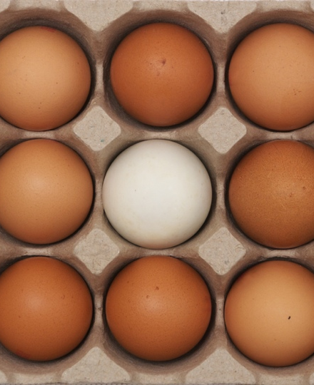
Differentiation and Positioning
Choosing a Differentiation and Positioning Strategy
Competitive advantage is an advantage over competitors gained by offering consumers greater value, either through lower prices or by providing more benefits that justify higher prices.
Notes:
To build profitable relationships with target customers, marketers must understand customer needs and deliver more customer value better than competitors do. To the extent that a company can differentiate and position itself as providing superior customer value, it gains competitive advantage.
But solid positions cannot be built on empty promises. If a company positions its product as offering the best quality and service, it must actually differentiate the product so that it delivers the promised quality and service. Companies must do much more than simply shout out their positions with slogans and taglines. They must first live the slogan.

Slide 26

Differentiation and Positioning
Choosing a Differentiation and Positioning Strategy
Identifying a set of possible competitive advantages to differentiate along the lines of:
Product
Services
Channels
People
Image
Notes:
Product differentiation: Premium audio brand Bose promises “better sound through research—an innovative, high-quality listening experience.”
To find points of differentiation, marketers must think through the customer’s entire experience with the company’s product or service. An alert company can find ways to differentiate itself at every customer contact point.
Through product differentiation, brands can be differentiated on features, performance, or style and design. Thus, Bose positions its speakers on their striking design and sound characteristics. By gaining the approval of the American Heart Association as an approach to a healthy lifestyle, Subway differentiates itself as the healthy fast-food choice.
Some companies gain services differentiation through speedy, convenient, or careful delivery.
Firms that practice channel differentiation gain competitive advantage through the way they design their channel’s coverage, expertise, and performance. Amazon.com, for example, sets itself apart with its smooth-functioning direct channels.
Companies can also gain a strong competitive advantage through people differentiation—hiring and training better people than their competitors do.
Even when competing offers look the same, buyers may perceive a difference based on company or brand image differentiation. The chosen symbols, characters, and other image elements a brand chooses must be communicated through advertising that conveys the company’s or brand’s personality.

Slide 27
Differentiation and Positioning
Choosing a Differentiation and Positioning Strategy
Choosing the Right Competitive Advantage
A difference to promote should be:
Important
Distinctive
Superior
Communicable
Preemptive
Affordable
Profitable
Notes:
Not all brand differences are meaningful or worthwhile, and each difference has the potential to create company costs as well as customer benefits. A difference is worth establishing to the extent that it satisfies the following criteria:
Important: The difference delivers a highly valued benefit to target buyers.
Distinctive: Competitors do not offer the difference, or the company can offer it in a more distinctive way.
Superior: The difference is superior to other ways that customers might obtain the same benefit.
Communicable: The difference is communicable and visible to buyers.
Preemptive: Competitors cannot easily copy the difference.
Affordable: Buyers can afford to pay for the difference.
Profitable: The company can introduce the difference profitably.
Many companies have introduced differentiations that failed one or more of these tests. Choosing competitive advantages on which to position a product or service can be difficult, yet such choices may be crucial to success. Choosing the right differentiators can help a brand stand out from the pack of competitors. For example, when Nokia introduced its Lumia 1020 smartphone, it didn’t position the phone only on attributes shared with competing models, such as user interface and speed. It positioned it as a smartphone with a 41 megapixel camera with a “reinvented zoom” and “full HD video” that fits today’s digital lifestyles.

Slide 28
Differentiation and Positioning
Choosing a Differentiation and Positioning Strategy
Positioning statement summarizes company or brand positioning using this form: To (target segment and need) our (brand) is (concept) that (point of difference)
Example : Positioning Statement for Evernote:
“To busy multitaskers who need help remembering things, Evernote is a digital content management application that makes it easy to capture and remember moments and ideas from your everyday life using your computer, phone, tablet, and the Web.”
Notes:
The company and brand positioning should be summed up in a positioning statement. An example using the above form is shown on the next slide.

Slide 29
Differentiation and Positioning
Communicating and Delivering the Chosen Position
Choosing the positioning is often easier than implementing the position.
Establishing a position or changing one usually takes a long time.
Maintaining the position requires consistent performance and communication.
Notes:
Once it has chosen a position, the company must take strong steps to deliver and communicate the desired position to its target consumers. All the company’s marketing mix efforts must support the positioning strategy. Positioning the company calls for concrete action, not just talk. If the company decides to build a position on better quality and service, it must first deliver that position.
Companies must closely monitor and adapt the position over time to match changes in consumer needs and competitors’ strategies. However, the company should avoid abrupt changes that might confuse consumers, and should evolve gradually as it adapts to the ever-changing marketing environment.

